Slide 1


The Road to Glory
How Pakistan’s Automobile Parts Industry Can Become Globally Competitive
or Edge of a Cliff
Pakistan Association of Automotive Parts & Accessories Manufacturers (PAAPAM)

Slide 2
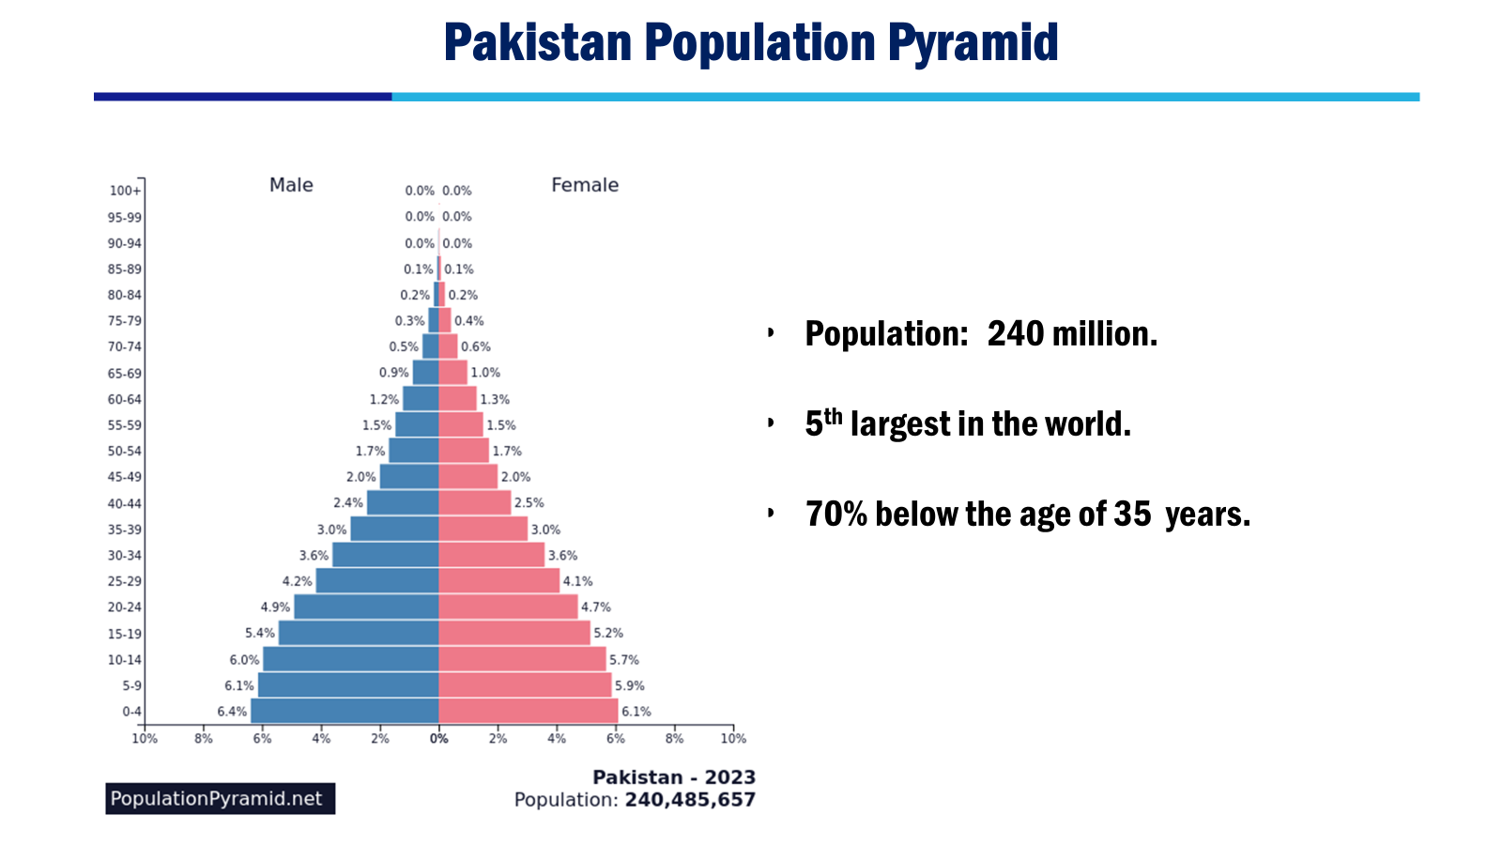

Slide 3
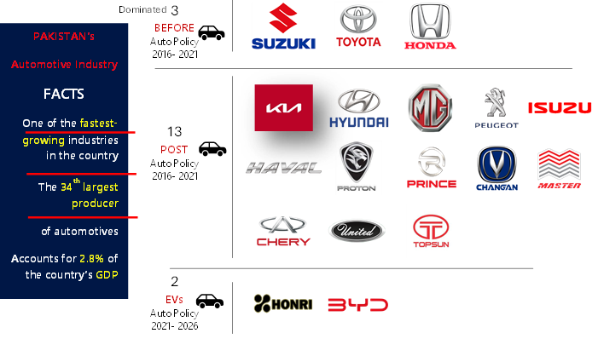
Automobile Brands Produced in Pakistan

Slide 4
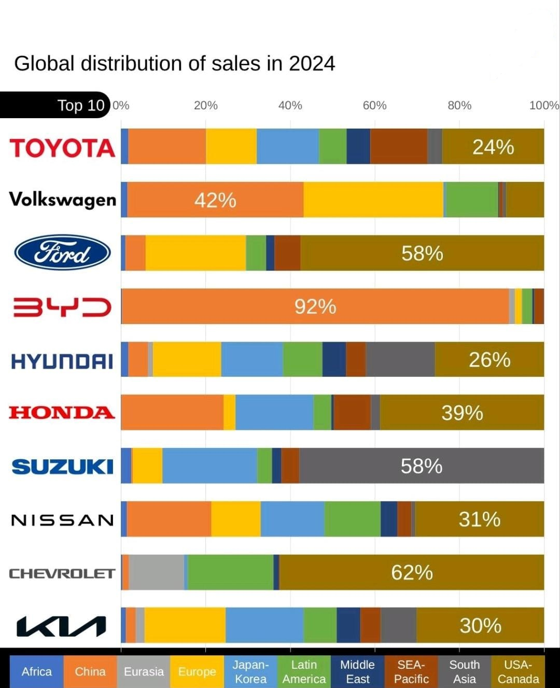
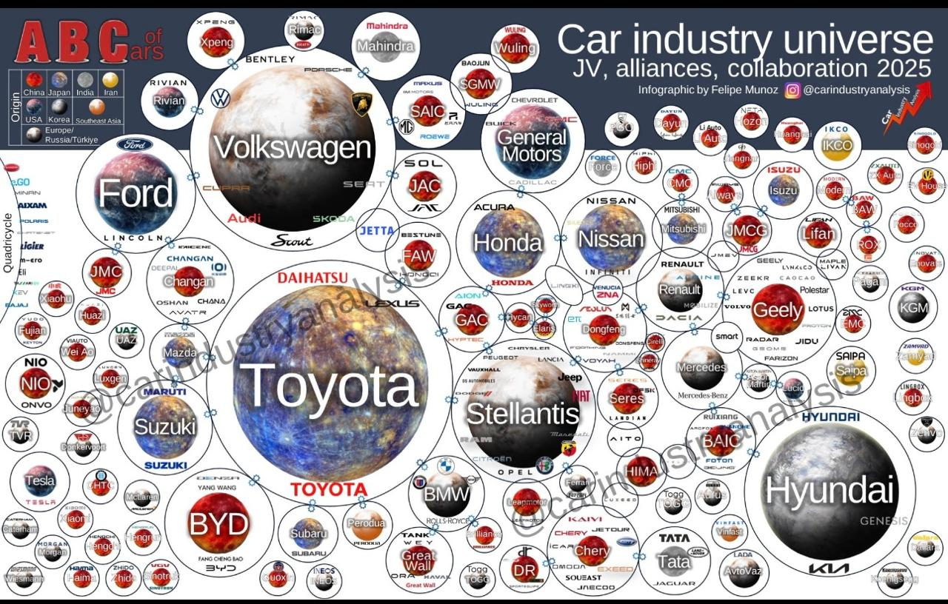
Global Connectivity in automotive brands
Top 10 Brands and respective Regional Presence
10.1 Mil.
8.5 Mil.
4.2 Mil.
4.5 Mil.
3.8 Mil.
3.8 Mil.
3.1 Mil.
3.1 Mil.
2.6 Mil.
2.9 Mil.
7 out of top 10 car brands are making vehicles in Pakistan

Slide 5
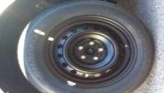

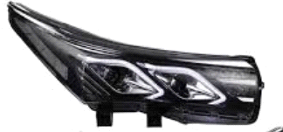
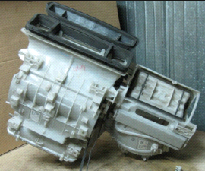
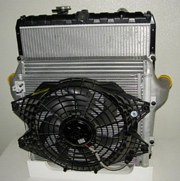
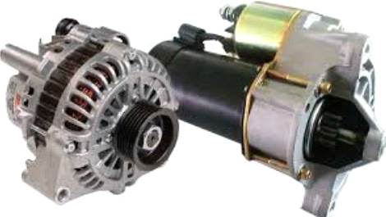
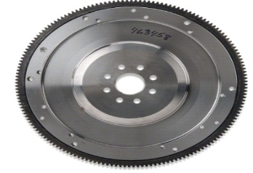
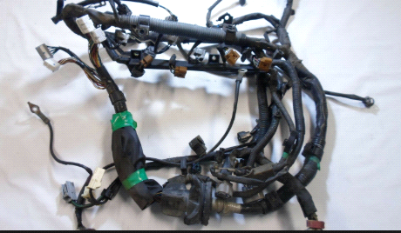
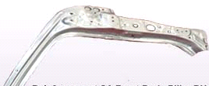
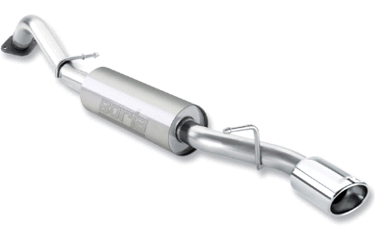
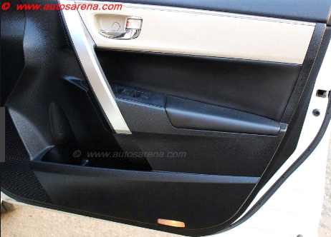
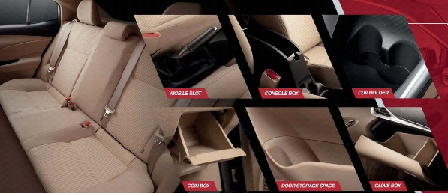

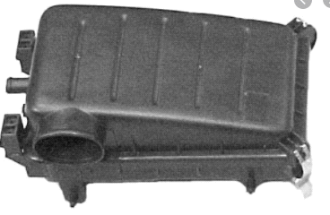
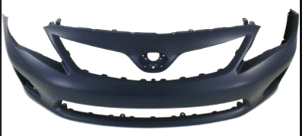
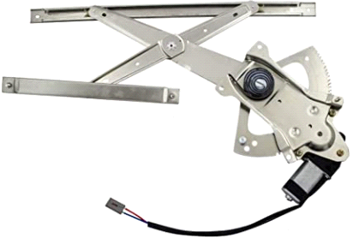

AUTOMOBILE PARTS PRODUCED IN PAKISTAN
Auto parts exports exceed US$ 200m under multiple HS codes
5

Slide 6
Major Localized Parts: Contributing towards Make in Pakistan
Starter
Alternator
Air Conditioners
Evaporators
Shock Absorbers
Radiators
Wiring Harness
Lamps (LED/Halogen Type)
Bumpers
Front Grill/Resin Parts
Seat Belts
Instrument Panel
Tyres
Rubber Hoses/Tubes
Steel Tubes
Audio/Navigation
Speakers
Batteries
Seats
Steering Wheels
Rims
Center Console
Door Trims
Window Regulators
Door Handles
Exhaust Muffler
Hilux Frame/Chassis
Steel Rims
Glass Wind Shield (Under Study)
Glass Door Windows
Fuel Tank Steel Type
Oil Filter
Doors
Hoods
Luggage
Skin Panels
  Roof
  Hood/Bonnet
  Lugg Door
  Side Door (all)
  Side Panels
  Floor CTR
  Floor Fr
  Floor RR
  Dash Panel
Cross Members
Side Sills

Slide 7
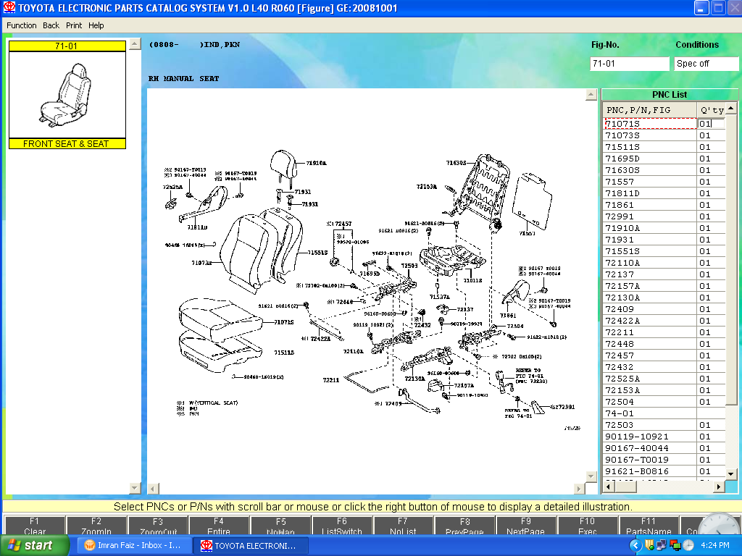

Definition Of Part
One can think
Seat is a part
Exploded View of Seat Assembly
Being made collectively by Procon, Razi Sons and TB.
One Seat set in a vehicle comprise with 520 No of Parts

Slide 8
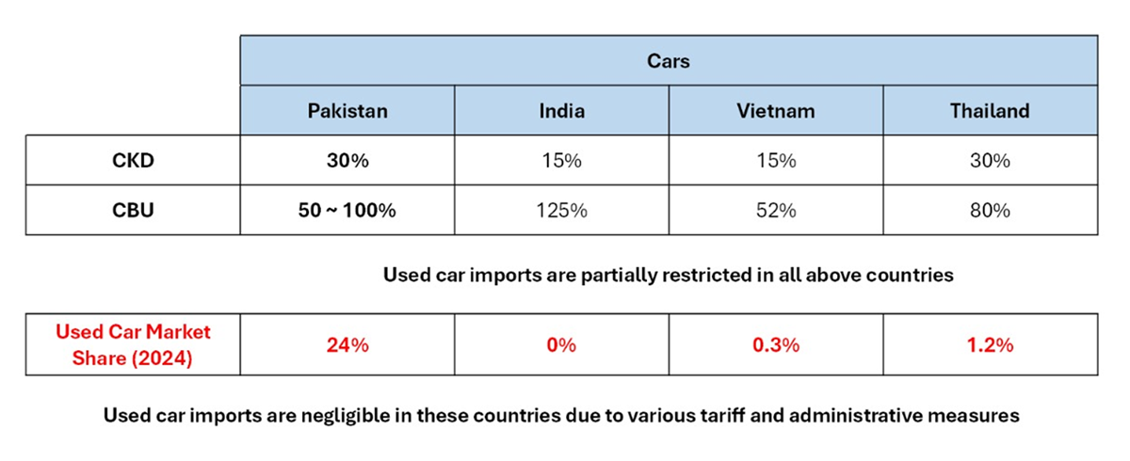
REGIONAL TARIFF COMPARISONS

Slide 9
Status Quo: "the existing state of affairs" or "the current situation“
Safety & security
Political stability
Policy consistency
Fixation on used cars
Regional benchmarking
Deep industry analysis & long-term vision
We need Reforms, but for whom and to fix what!
Nationalization in the 1970s was also a Reform….
What is our end-game?

Slide 10

Preamble

Slide 11
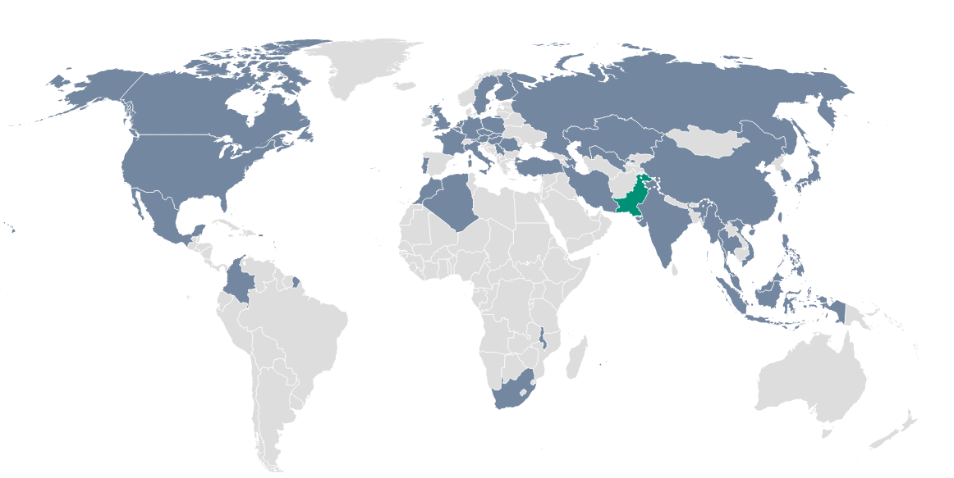



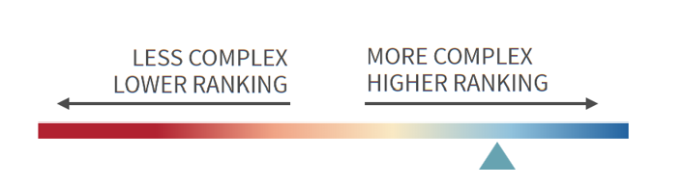


Automobile Parts – A Global Perspective
Automotive manufacturing is among top-tier industries globally in Economic Complexity Index
Only 46 countries have the exclusive capability to produce automobiles.
Pakistan is proudly one of these countries producing automobile (ranks 35th globally).
Pakistan is one of the 46 auto-producing countries in the world
Pakistan’s Achievements
5,000+
Decades of investment in plants, machinery, and human capital
Components localized
$1.25 Bn
1.83 million
Livelihoods tied to the sector
Import substitution through local value addition
Automobile parts production is highly complex
Automobile parts industry ranking

Slide 12
How India became a major exporter?
Policy stability over decades
Protected home market until scale achieved
Attract foreign OEMs and gave them reasons to stay
Push localization beyond assembly
Export incentives from day one
Opened export markets through FTAs
India didn’t get here by chance; it got here by choosing stability over short-term politics. And that’s the choice we face today.

Slide 13
Key Lessons for Pakistan
Investors commit only when policy stability is there
Market protection is a necessity, not a luxury during growth stage
Performance-based incentives drives results such as exports and localization
Raw material handicap needs to be fixed to become competitive against regional peers
Trade agreements/FTAs opens export doors
Testing labs are crucial to ensure parts qualify for foreign validation
Gradual localization builds capability

Slide 14




Key Lessons for Pakistan
 |  | Pakistan | India | Thailand | Vietnam
 | GDP Growth | 2.7% | 6.2% | 1.8% | 5.2%
 | Policy Consistency | Low | Med-High | High | High
 | Ease of Doing Business Rank | 108 | 63 | 21 | 70
 | Political Instability Rank | 7 | 21 | 36 | 45
How can we compete with the region with these indicators? It is not the failure of just auto industry, but policy makers, economic managers and decision makers

Slide 15
Key Lessons for Pakistan
Yet the auto and auto parts industry has played its part in remaining competitive against all economic, political and safety odds…
Pakistan can even potentially outperform India in terms of price competitiveness if volumetric sales grow due to economic stability…
And tap into $181 billion regional export corridor

Slide 16

Pakistan’s Story
A Series of Missed Opportunities

Slide 17
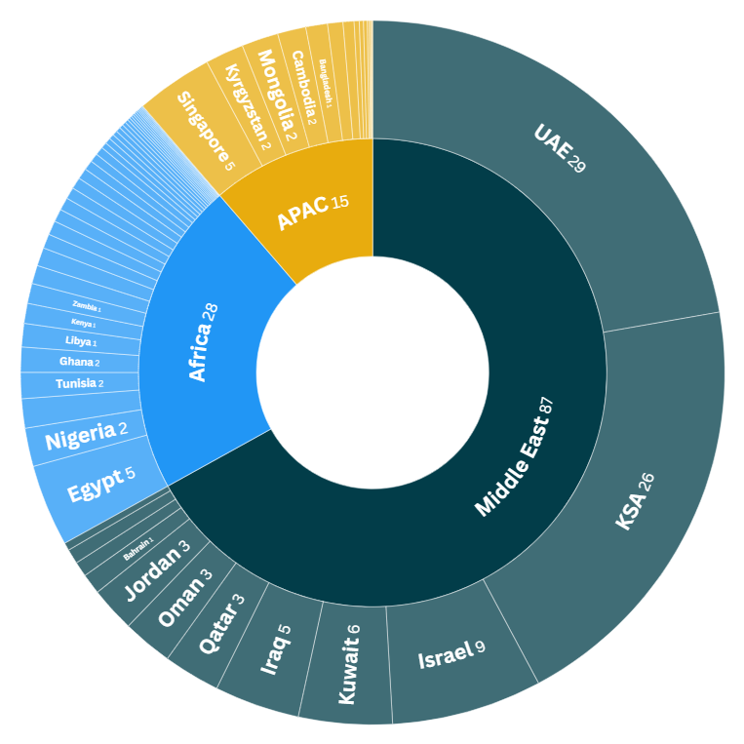



Missing out on $131 billion export corridor
We’re in an elite club of 46 car-producing countries — and we have one of the best locations for exports to GCC, Africa, and APAC, a non-auto producing market relying solely on imports. But without scale and stability, we’re just watching others take our share.
Capturing just 5% of this corridor could unlock
$6.5 billion
in annual exports
This is 70x the current levels
The Miss
Small domestic scale keeps cost uncompetitive
The $131bn Trade Corridor – Total Auto Imports (USD Bn)
Our Edge
Geographically closer to these regions than India, Thailand, or China
Policy volatility discourages export-focused investments
1,200 vendors with UN and ISO certifications

Slide 18




Motorization Levels - a National Wakeup Call
 |  |  | Pakistan | India | Thailand | Vietnam
 | GDP/Capita | USD | 1,824 | 2,878 | 7,767 | 4,806
 | Population | Millions | 247 | 1,451 | 72 | 101
 | Annual Production | No. | 148,209 | 6,014,691 | 1,468,997 | 175,661
 | Motorization | Cars per 1000 persons | 20 | 33 | 147 | 46
Just 20 cars per 1000 persons…
If we can’t sell to our own people due to poor income level, how will we sell to the world?
If GDP grows, cars follow…
GDP per capita strongly correlated with motorization levels
Pakistan is far below the take-off point, with GDP/capita far below the $2,500-$3,000 “acceleration” threshold.
Motorization will not rise until macroeconomic governance is addressed

Slide 19





Aftersales Market – PKR 155 billion Goldmine
We have the market. We have the capability. But we’re letting it be captured by smugglers and tax evaders.
96%
Share of passenger/LCVs in total on-road vehicles
PKR 155 Bn
Untapped aftersales market even at a 1% per capita spend on LCVs
39 Mn
Total on-road vehicles
5-10x
Volume typically generated by aftersales market compared to OEMs
No retail-stage sales tax enforcement, compliant local vendors compete with tax-evading products.
Market dominated by under-invoiced, mis declared, and smuggled imports

Slide 20
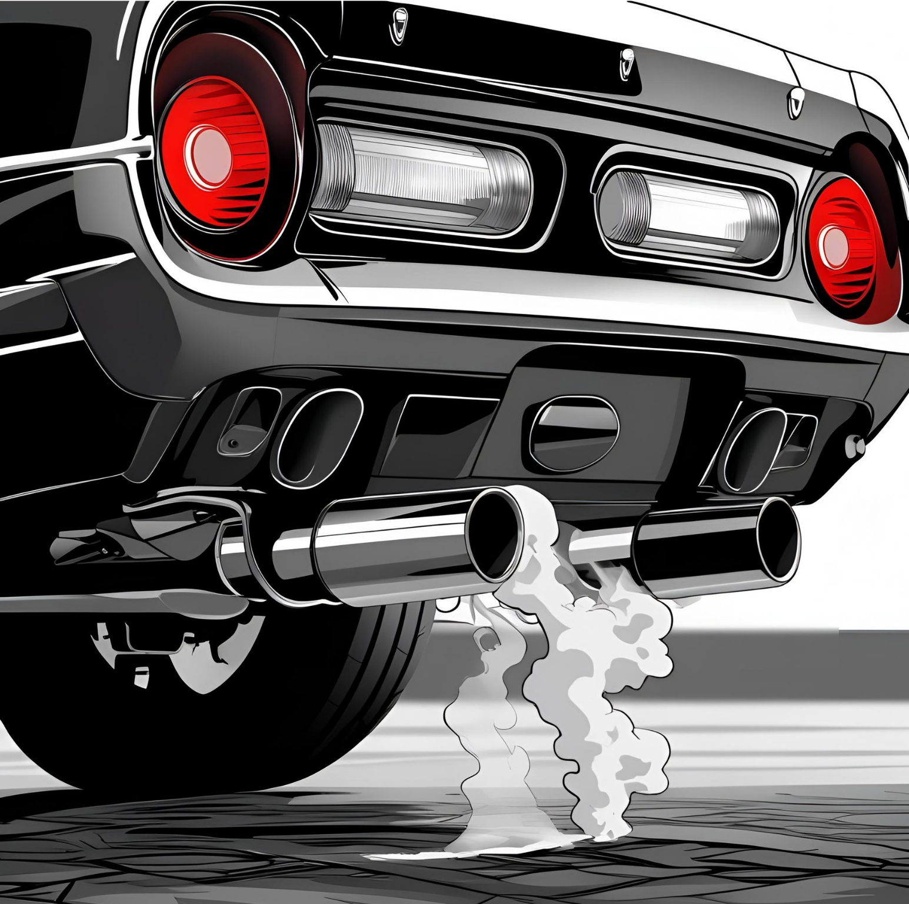
Auto Parts Industry
Myths vs Reality

Slide 21
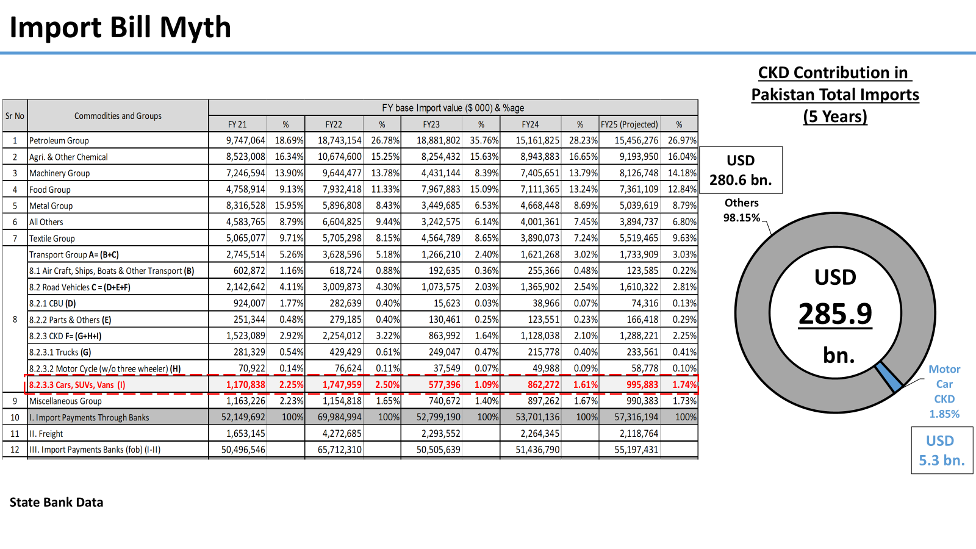
Motor Car (CKD) Contribution in Pakistan Import Bill – FY 25

Slide 22
Quality & Technology Perception
Myth: Car assemblers merely join imported parts
Myth: Local parts are low quality & old technology
FACT
FACT
40%-60% of parts, including engines and transmissions, are made locally.
Local auto parts industry sustains 1.83 million livelihoods and meets global ISO/UN standards.
Vendors meet European safety & Japanese inspection standards
Modern tooling + ISO/UN compliance = globally competitive parts

Slide 23
Quality & Technology Perception
Myth: Local Industry offers obsolete models with little choice
Myth: Pakistan is dependent on foreign technology for manufacturing
FACT
FACT
Pakistan’s market covers the full spectrum — ICE, hybrids, plug-ins, and EVs.
Market offers entry to premium models, on par with regional markets
Policy inconsistency, not skill, drives reliance
Past failures (e.g., Adam Revo) show that with stable policy + R&D, Pakistan can build its own platforms

Slide 24
Price & Profit Myths
Myth: Car assemblers enjoy unreasonably large profits
Myth: Local cars are exorbitantly costly and out of reach for most
Myth: Assemblers have made arbitrary price increases
FACT
FACT
FACT
Auto industry average margins just 10% vs 32%–70% in other sectors
Small volumes & policy flip-flops keep returns modest despite investment
35–58% of car price = taxes, not production cost.
Cutting duties won’t lower prices much, but will cripple industry & jobs
Increases follow currency swings, tax changes, and cost hikes, not arbitrary calls.
Car prices are up 104%, far below fertilizer (170%) and cement (160%), and in line with inflation and rupee depreciation.

Slide 25
Market Manipulation Myths
Myth: Assemblers suppress production to create shortages and charge premiums (“own-money”)
Myth: Local cars have very long delivery lead times
FACT
FACT
With 500K installed capacity, utilization low as 20%-30%, no assembler gains from idle lines.
Premiums driven by speculative buyers and brokers, not OEMs.
Most models delivered within 60 days
Law requires OEMs to pay KIBOR +3% if deliveries exceed 60 days

Slide 26
Protectionism & Policy Myths
Myth: The industry is unfairly and unnecessarily protected — more players is the answer
Myth: The industry can’t survive without government protection
FACT
FACT
Pakistan is less protected: reduced CBU tariffs + 60% duty cuts for used imports (20–25% of market)
Peers kept high tariffs & banned used cars until scale; Pakistan lowered barriers mid-growth.
The industry already competes under intense volume, cost, and policy pressure
Still delivers 35–58% in taxes and sustains vendors/.

Slide 27
Import vs Local Manufacturing Myths
Pakistan benefits more from importing vehicles than manufacturing
Used car imports have no adverse effect on domestic volumes
Import of used cars is beneficial for consumers & government
FACT
FACT
FACT
Imports = one-time FX outflow, no jobs or industry.
Local manufacturing = sustains 1.83 Mn jobs, vendors, tech transfer & tax revenue.
Average used car imports in Pakistan = 34,000 taking up to 25% of the market.
Each displaces a local car, hurting 1.83M jobs & local vendors.
Any short-term price relief comes at a high cost — forex drains, lost local jobs, weaker tax revenue, and stalled industrial growth.
The gain is temporary; the damage is lasting.

Slide 28

Pakistan’s Auto Parts Industry Challenge

Slide 29
Chronic Policy Inconsistency
In Pakistan, auto policy changes faster than the model year—tariffs, targets, and incentives keep shifting, while promised goals and support never materialize, leaving the industry stuck in first gear.

Slide 30
Used Car Imports
Almost a quarter of Pakistan’s car market is now fed by 3–5-year-old, fully-depreciated imports—undercutting local production, wiping out billions in parts sales, and killing tens of thousands of jobs. No serious auto-producing country allows this; yet in Pakistan, it’s become the single biggest policy own-goal for the industry.
PKR 60 Billion
Annual loss of revenue for APMs
40,000
Direct job losses
Pakistan’s anomaly: only auto-producing country in the APAC region to import used cars to such an extent

Slide 31
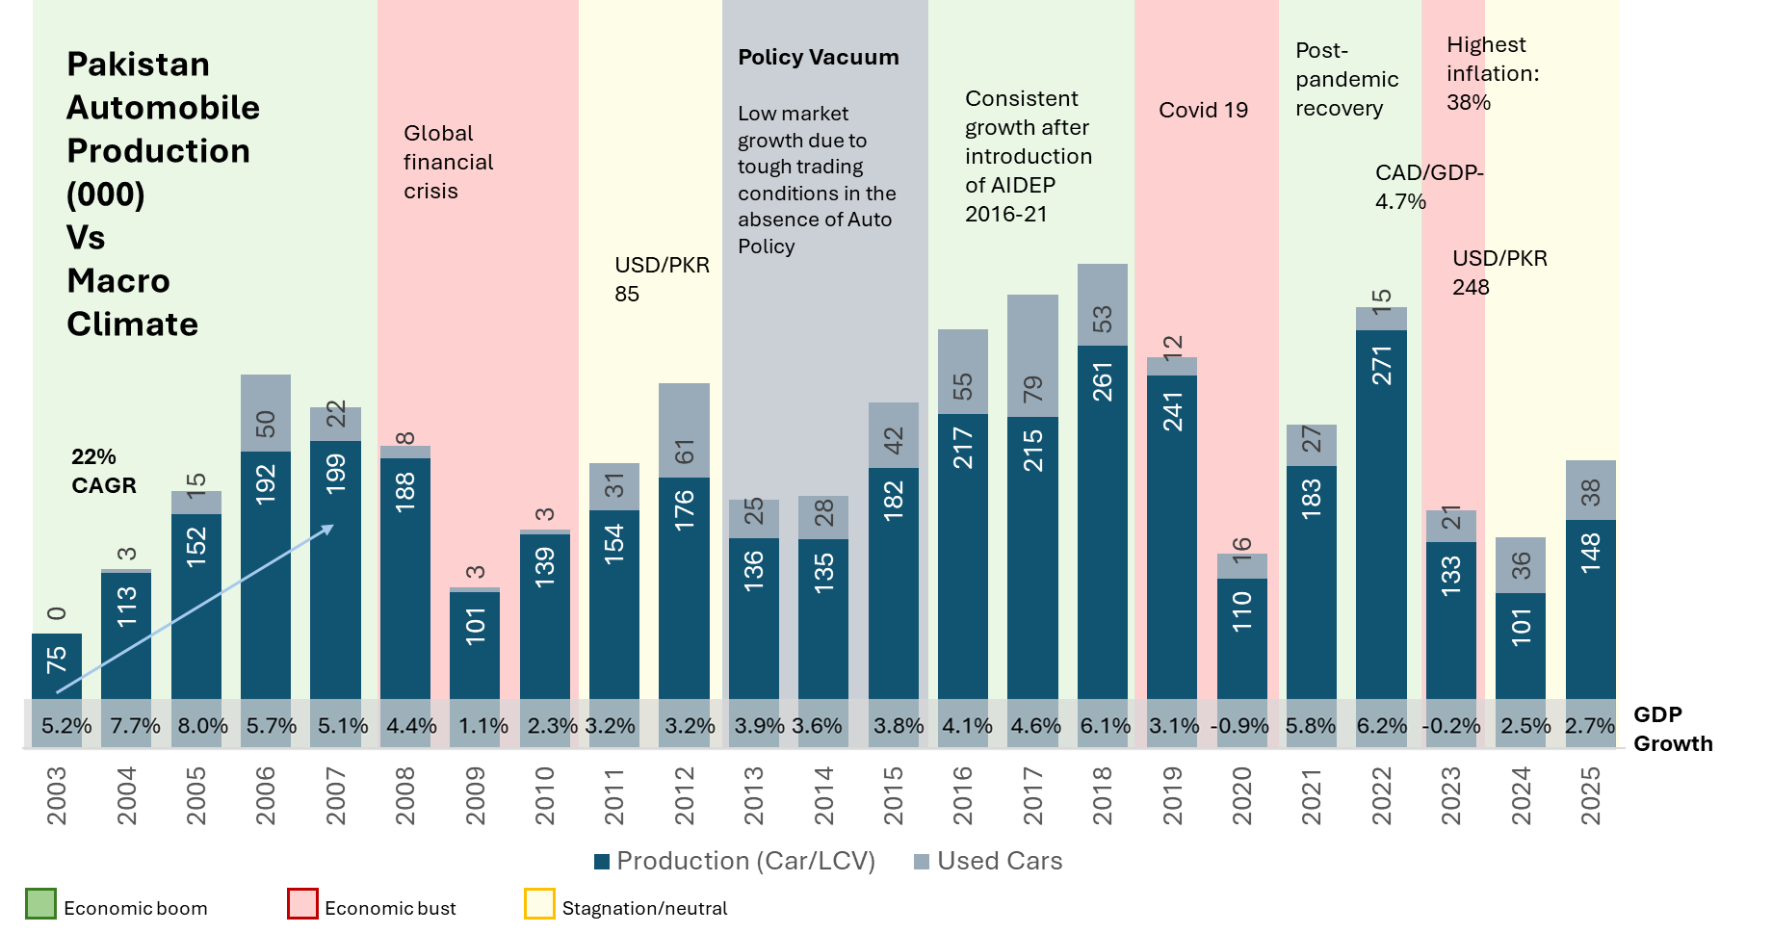
Boom-Bust Cycles and Stagnation
Sales surge in booms, collapses in busts.
Output in 2025 = 2005 levels, despite a population jump of 90Mn.
Pakistan’s auto stagnation isn’t an industry failure—it’s a macro trap of instability, boom-bust cycles, and policy whiplash that no manufacturer can scale against.
Economic boom
Economic bust
Stagnation/neutral

Slide 32
FDI Gap
FDI remains low, average $2bn a year, Vietnam on the other hand recorded $4bn in just January 2025.
Policy whiplash, poor infrastructure, and low stability keep global investors away.

Slide 33



Lack of Credit Financing
Without deep credit markets and affordable auto loans, Pakistan’s young middle class stays in the showroom, not on the road.
Domestic car demand hinges on credit availability
Credit penetration (11% of GDP vs peers’ 50%-125%)
40% middle class, >50% under 30, but limited access to car finance
Policies must boost demand via credit access, not just supply reforms

Slide 34
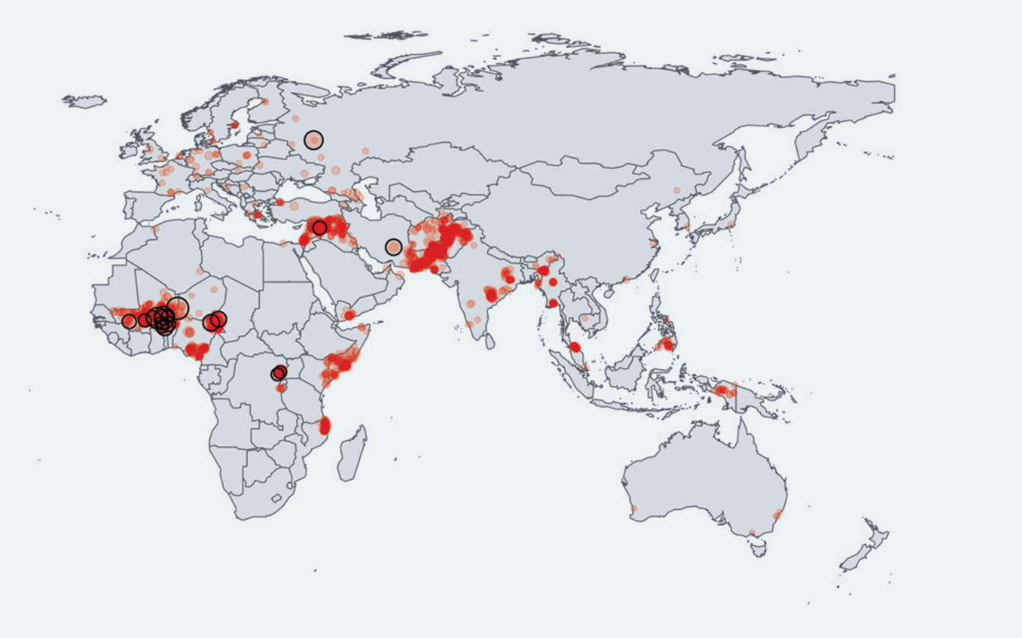
Terrorism, Security, and Perception Barriers
Pakistan is a hotspot for most violent terrorist activity in the region…
…and ranks among worst on Global Terrorism Index

Slide 35


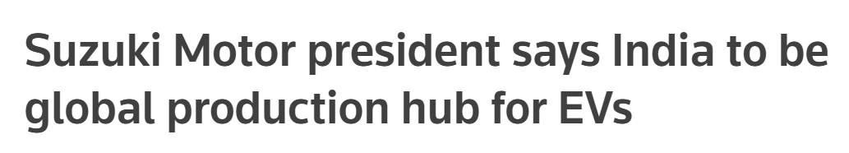
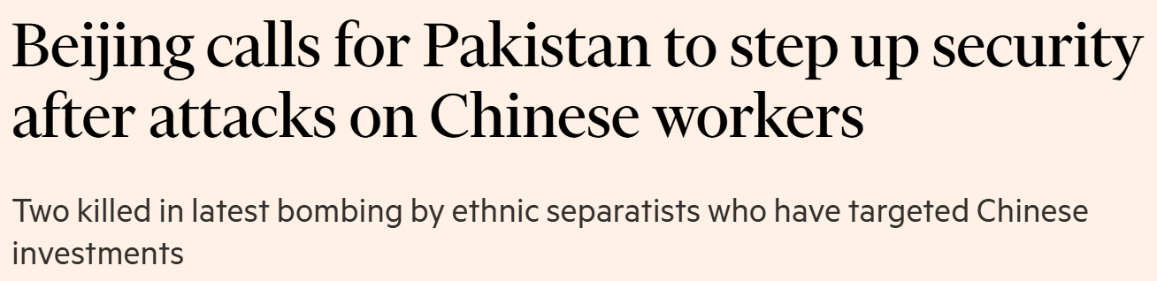

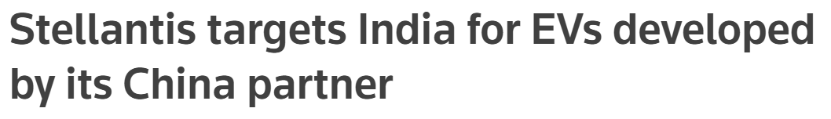
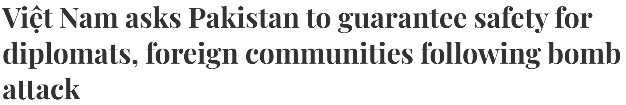

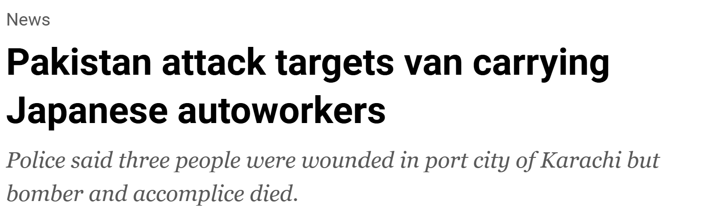
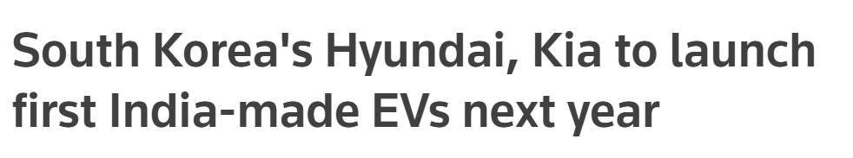
Terrorism, Security, and Perception Barriers
Coverage of Pakistan by International Media…
…vs India

Slide 36





Other Challenges Affecting Export Competitiveness
Material dependency due to absence of local raw material industry
Absence of export facilities
Low domestic volumes
Lack of testing & certification facilities
Uncompetitive utilities (such as electricity)

Slide 37

PAAPAM’s Comments

Slide 38
On IMF Prescriptions
IMF Position (per April 2025 report) | PAAPAM’s Response
Automotive protection imposes “large welfare costs” on consumers by keeping prices high. | High car prices = taxes, not localization Removing protection cuts jobs & FX savings, not prices.
Automotive protection is “extensive,” raises prices, causes inefficiency; tariffs should be cut and preferential local support reduced. | Small scale (150k units), no raw materials Cascading tariffs needed until scale is reached Removing protection now = end of localization
Ban on commercial used car imports should be removed; imports allowed with phased duty premium to 2030. | No auto nation allows large used imports Loopholes = 25% of market, killing vendor demand Must close loopholes, not expand
High tariffs create “anti-export bias”; flatten duties on parts and CKD/CBU to lower costs. | Export barrier = FDI & security, not tariffs Inputs already at 0% duty under EFS Flattening tariffs = no localization, more cheap imports
Remove additional duties on localized parts and end special SRO-based protections. | Ending duties kills SME vendors — cascading tariffs are safeguards, not distortions.
Lower duties to improve affordability. | Taxes = 35%-58% of car price; weak credit blocks affordability Tariff cuts won’t lower prices, they’ll only kill jobs

Slide 39
On National Tariff Policy 2025-30
Premature Liberalization
Cascading Tariff Collapse
Flawed Assumptions
Fiscal Risk
Wrong Sequencing
Flattening duties to 15% by 2030 ignores high energy costs, volatile FX, low FDI, and financing gaps.
Removes incentive to localize, risking PKR 300bn+ import substitution, PKR 100bn+ vendor investment, and 1.83m jobs.
Growth projections ignore structural constraints; past zero-duty inputs under EFS didn’t boost competitiveness.
PKR 228bn revenue loss likely widens deficit in a low tax-to-GDP economy
Peers kept high CBU tariffs until achieving scale/export readiness — Pakistan is liberalizing before maturity

Slide 40

Pertinent Questions

Slide 41






In Case the Industry Shuts Down…
 |  | Is there any alternate plan for 1.83 Mn jobs, PKR 878 Bn annual income, and PKR 302 Bn taxes at risk?
 |  | Can Pakistan absorb a $1 Bn import shock without derailing IMF targets?
 |  | How will we meet 2030 NDC/EV goals while allowing high-emission used cars?
 |  | Is duty reduction the only tool, when credit access is the real constraint?
 |  | How will we reach $100 Bn exports without the auto parts sector’s $6.5 Bn potential?
 |  | Why focus on premium cars, when 40% are middle-class needing affordable mobility?
Dismantling the auto parts industry will trigger an irreversible jobs, imports, climate, fiscal, and competitiveness shock that no fragile economy can absorb — with no credible alternative plan in place.

Slide 42

AUTO PARTS
PAAPAM’s
Recommendations

Slide 43
PAAPAM’s Strategic Recommendations
Now
Next
Immediate Actions
Suspend NTP 2025-30 tariff flattening for autos
Regulate used car imports via mandatory JAAI certification
Pilot vehicle scrappage policy
Targeted auto financing support
Freeze policy changes until FY27 to restore investor confidence
Immediate relief for SMEs
AIDEP 2026 Framework
Permanent ban on used car imports
Legislate cascading tariff structure
Make scrappage policy permanent
Double auto-credit penetration
Introduce export integration targets
Offset lower duties via scale-driven VAT & income tax gains
Institutionalize policy stability
Localize EV/Hybrid technology
3S obligation for imported models

